Slide 1
Spring Transaction Management

Slide 2
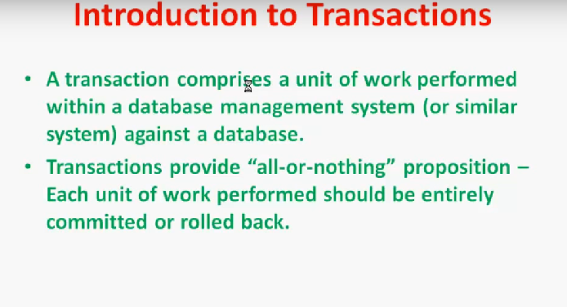

Slide 3
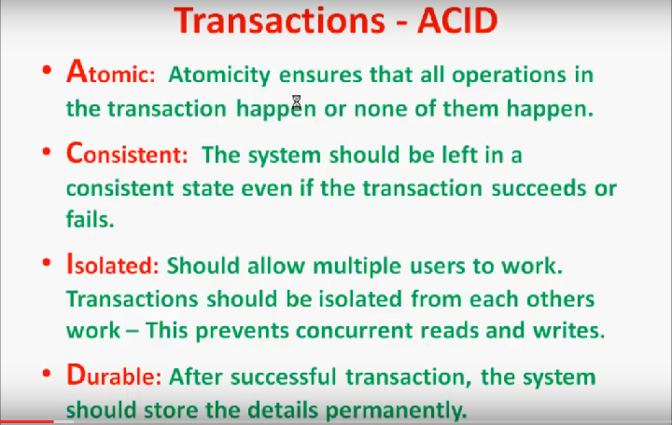

Slide 4
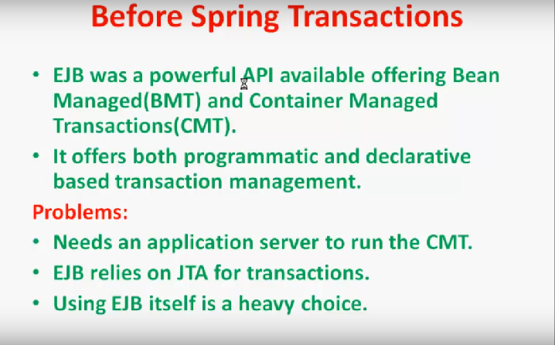

Slide 5
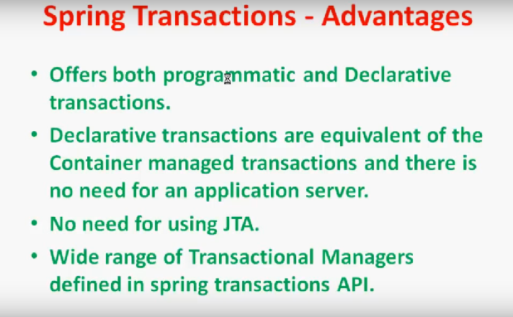

Slide 6
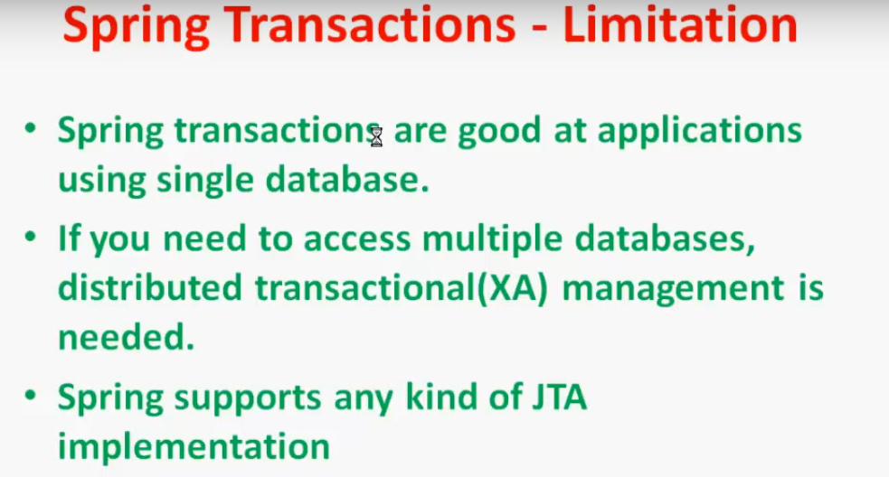

Slide 7
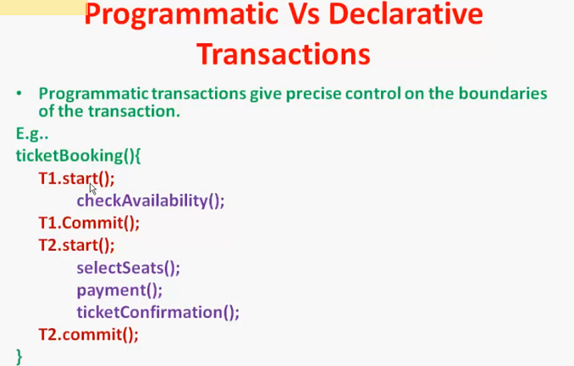

Slide 8
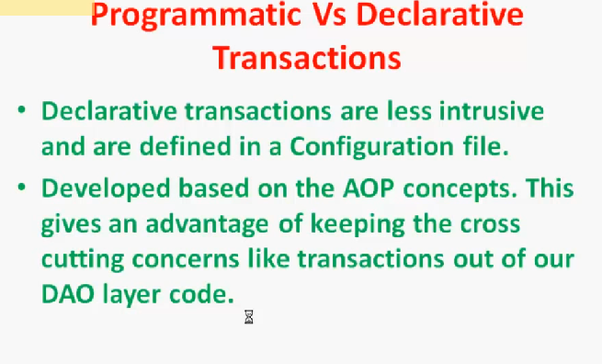

Slide 9
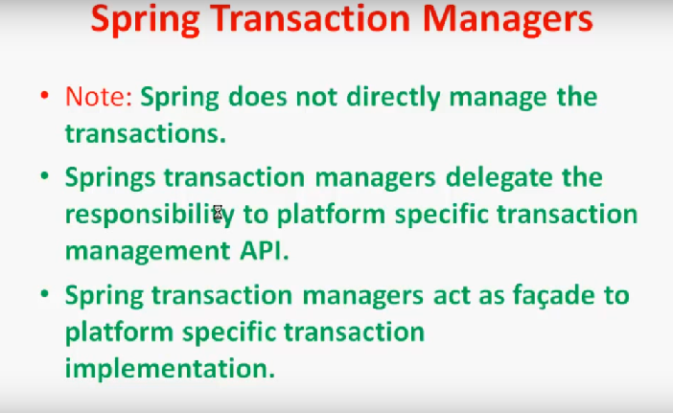

Slide 10
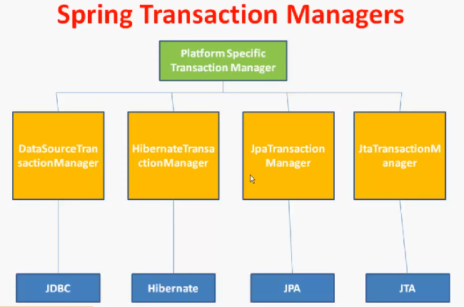

Slide 11
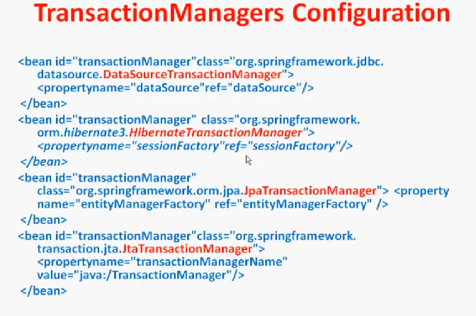

Slide 12
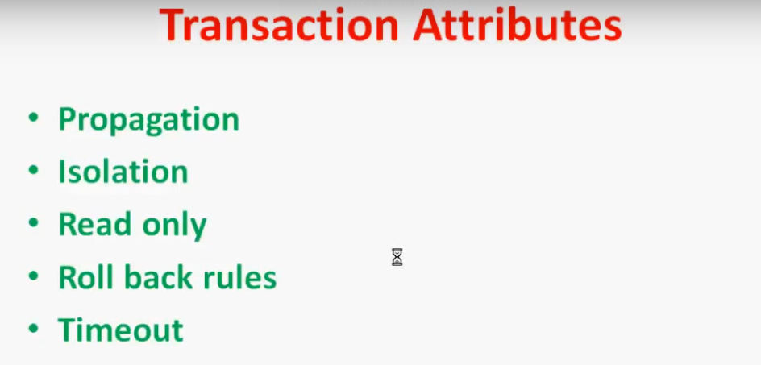

Slide 13
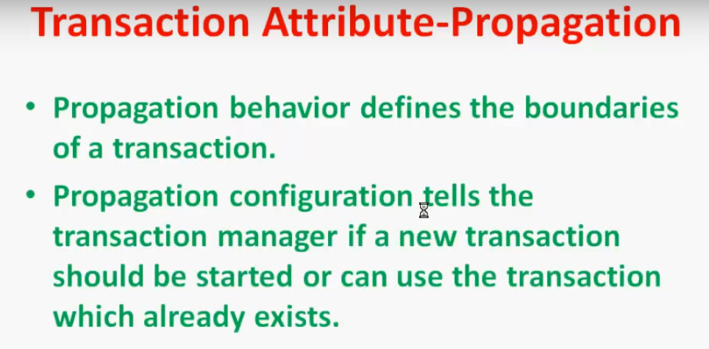

Slide 14
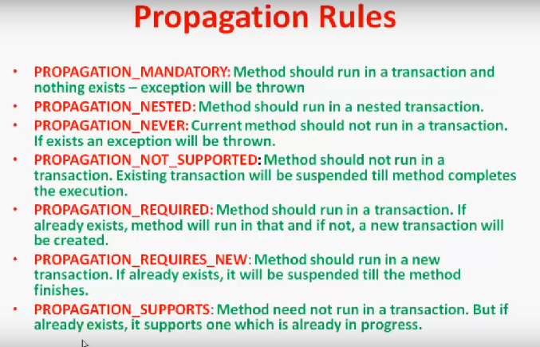

Slide 15
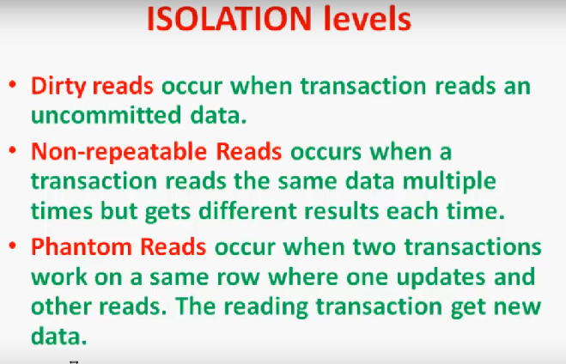

Slide 16
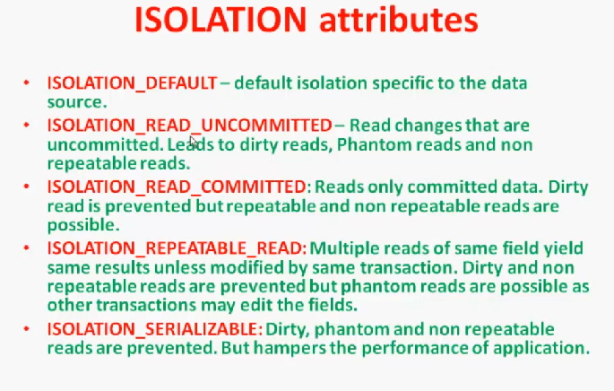

Slide 17
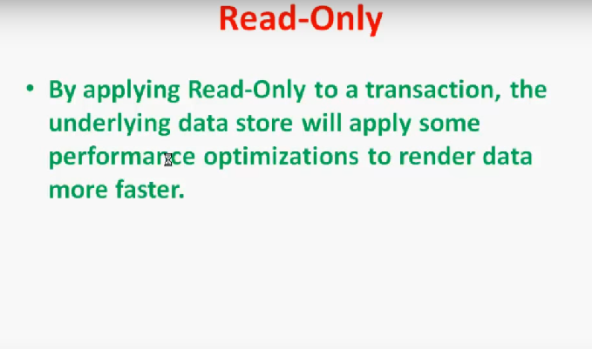

Slide 18
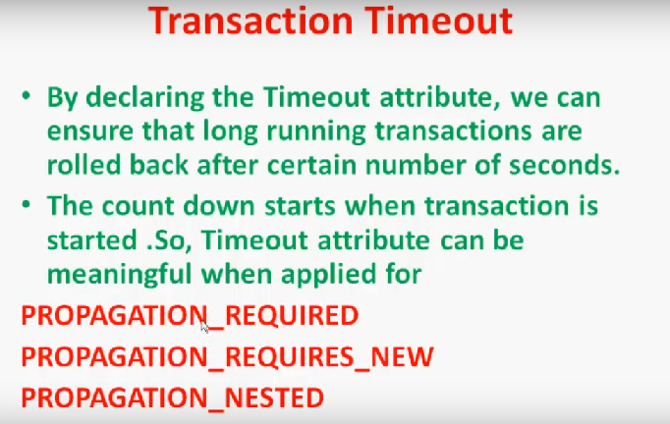

Slide 19
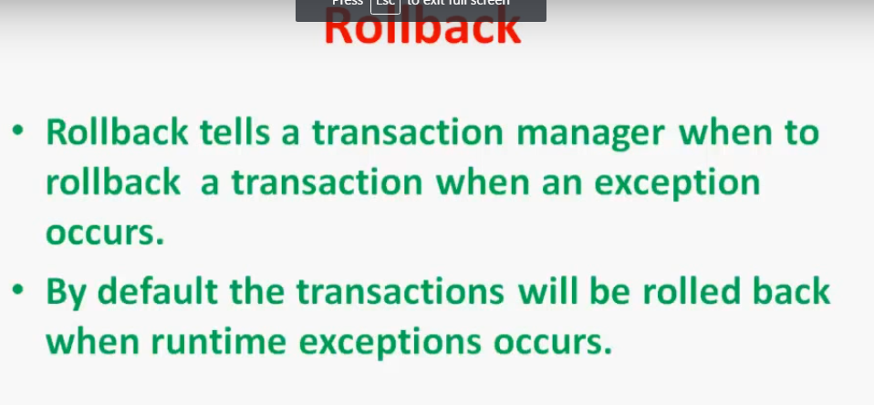

Slide 20
Example explaining Declarative Transaction @Transactional
Consider example where client want to createDepartment and internally departmentService call createEmployee of employeeService.
Both methods are annoted with @Transactional attribute.
When @Transactional is found on method it is intercepted by proxy.
Later proxy object will be created which is posted in next site.

Slide 21
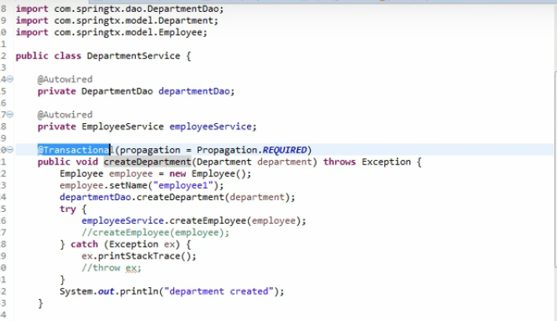
DepartmentService Class EmployeeService class Here createDepartment is outer method whereas createEmployee is inner method.

Slide 22
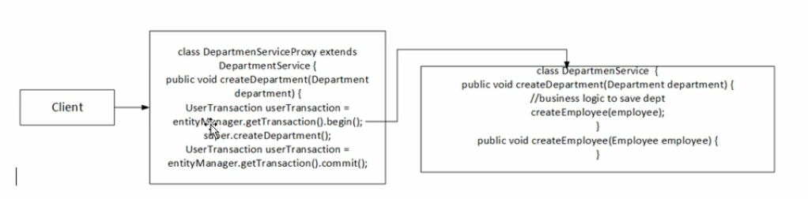
Here client call createDepartment method of department service class.
Spring internally create proxy object which handle transaction related things.

Slide 23
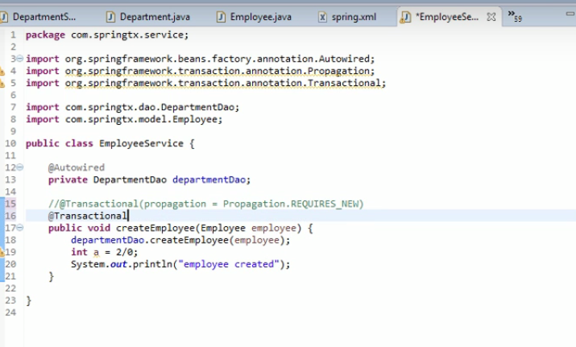
EmployeeService class

Slide 24
Important catch : if createEmployee method is added in same DepartmentSrvice class then transaction will not be get intercept and hence it won’t work as expected. Check below example

Slide 25
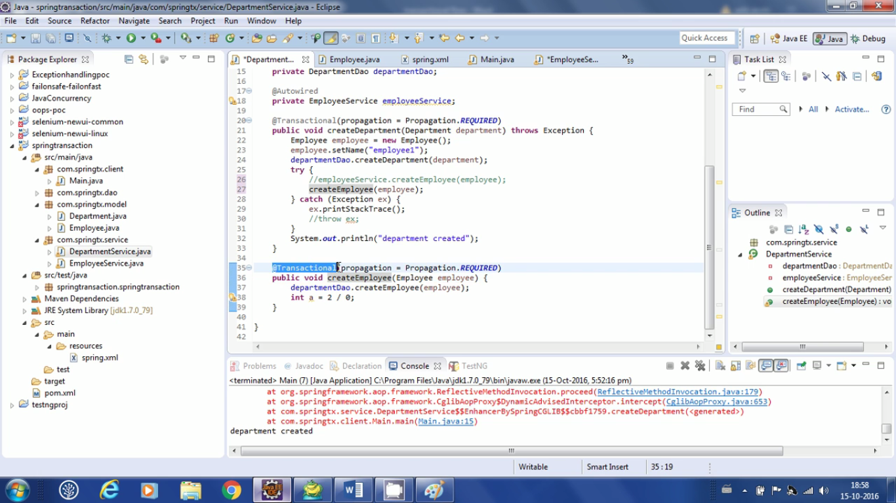
Here createEmployee is added in same class DepartmentService class

Slide 26
What will happen if added in same class ?
In Above class having createEmployee in same class proxy will not able to intercept above transactional method even if we annoted it with @Transactional
Hence we need to create other bean class having createEmployee method. Transactional flow is shown in below diagram.

Slide 27
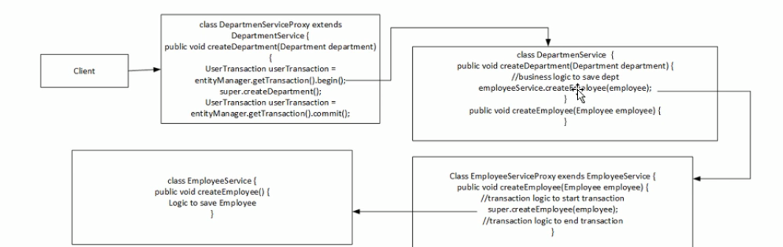
Transactional flow in case of Separate EmployeeService Bean

Slide 28
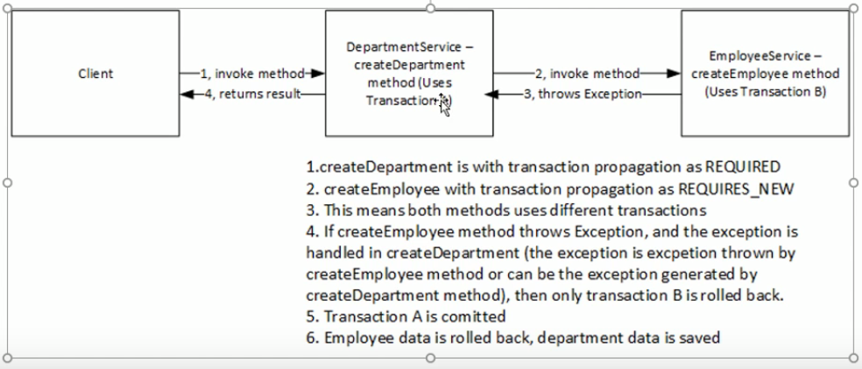
If createEmployee is annoted with @Transactional(propogation=Propogation.REQUIRED_NEW)

Slide 29
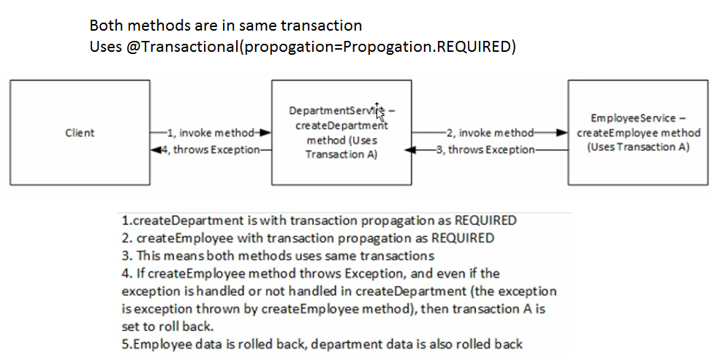

Slide 30
Spring Transaction Management Theory
Spring, on initializing application context, creates proxies when it comes across classes marked with @Transactional.
@Transactional can be applied at class level or method level. Applying it at class level means all the public methods defined in the class are transactional.
The kind of proxy Spring creates i.e. Jdk Proxy or CGLIB proxy, depends on the class in which the method is marked transactional.
If the class implements atleast one interface, Spring creates a Jdk dynamic proxy. This proxy implements the same interface as the original class does and intercepts the interface methods with transaction maintenance logic.
It delegates the call to the original object composed in it. Suppose the class does not implement any interface, Spring creates a CGLIB proxy. This proxy extends the original class and overrides the public methods

Slide 31
<tx:annotation-driven/>
You can omit the transaction-manager attribute in the <tx:annotation-driven/> tag if the bean name of the PlatformTransactionManager that you want to wire in has the name transactionManager. If the PlatformTransactionManager bean that you want to dependency-inject has any other name, then you have to use the transaction-manager attribute explicitly, as in the preceding example.
The @EnableTransactionManagement annotation provides equivalent support if you are using Java based configuration. Simply add the annotation to a @Configuration class. See the javadocs for full details.

Slide 32
Method visibility and @Transactional
When using proxies, you should apply the @Transactional annotation only to methods with public visibility.
If you do annotate protected, private or package-visible methods with the @Transactional annotation, no error is raised, but the annotated method does not exhibit the configured transactional settings.
Consider the use of AspectJ (see below) if you need to annotate non-public methods.

Slide 33
Proxy Mode
In proxy mode (which is the default), only external method calls coming in through the proxy are intercepted.
This means that self-invocation, in effect, a method within the target object calling another method of the target object, will not lead to an actual transaction at runtime even if the invoked method is marked with @Transactional.
Also, the proxy must be fully initialized to provide the expected behaviour so you should not rely on this feature in your initialization code, i.e. @PostConstruct.

Slide 34
AspectJ mode
if you expect self-invocations to be wrapped with transactions as well.
In this case, there will not be a proxy in the first place; instead, the target class will be weaved (that is, its byte code will be modified) in order to turn @Transactional into runtime behavior on any kind of method.

Slide 35
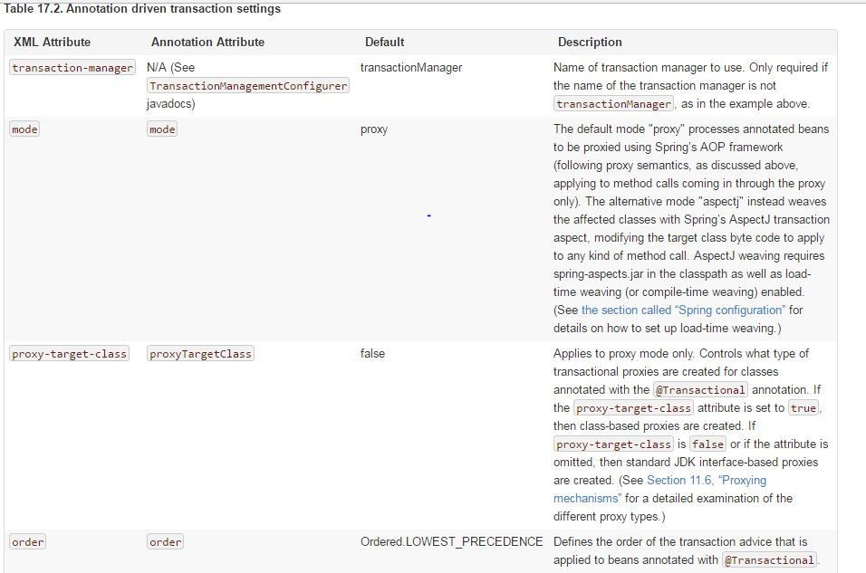

Slide 36
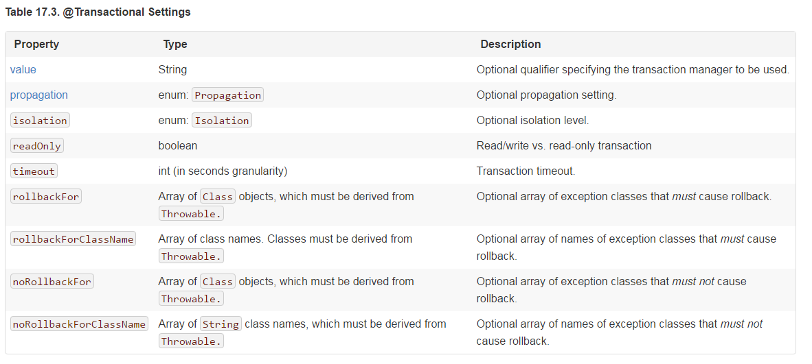

Slide 37
proxy-target-class
The proxy-target-class attribute controls what type of transactional proxies are created for classes annotated with the @Transactional annotation.
If proxy-target-class is set to true, class-based proxies are created. If proxy-target-class is false or if the attribute is omitted, standard JDK interface-based proxies are created.

Slide 38
EnableTransactionManagement
@EnableTransactionManagement and <tx:annotation-driven/> only looks for @Transactional on beans in the same application context they are defined in.
This means that, if you put annotation driven configuration in a WebApplicationContext for a DispatcherServlet, it only checks for @Transactional beans in your controllers, and not your services.

Slide 39
Programmatic transaction management
The Spring Framework provides two means of programmatic transaction management:
Using the TransactionTemplate.
Using a PlatformTransactionManager implementation directly.
The Spring team generally recommends the TransactionTemplate for programmatic transaction management.

Slide 40
TransactionTemplate
The TransactionTemplate adopts the same approach as other Spring templates such as the JdbcTemplate. It uses a callback approach
Application code that must execute in a transactional context, and that will use the TransactionTemplate explicitly, looks like the following.
You, as an application developer, write a TransactionCallback implementation (typically expressed as an anonymous inner class) that contains the code that you need to execute in the context of a transaction.
You then pass an instance of your custom TransactionCallback to the execute(..) method exposed on the TransactionTemplate.

Slide 41
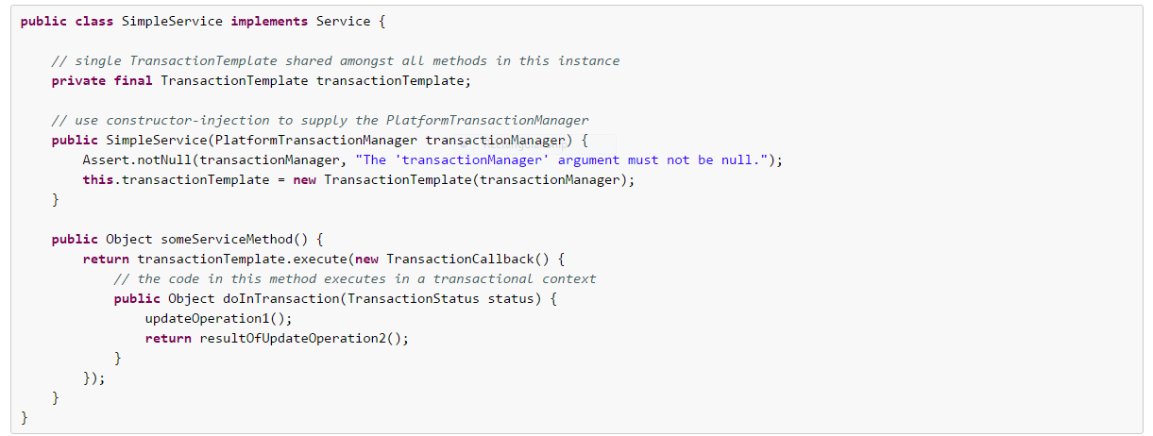

Slide 42
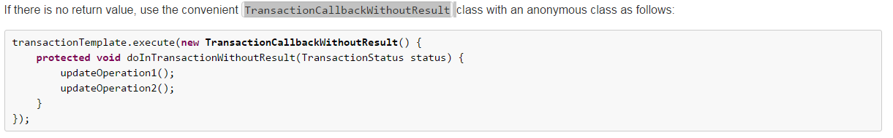

Slide 43
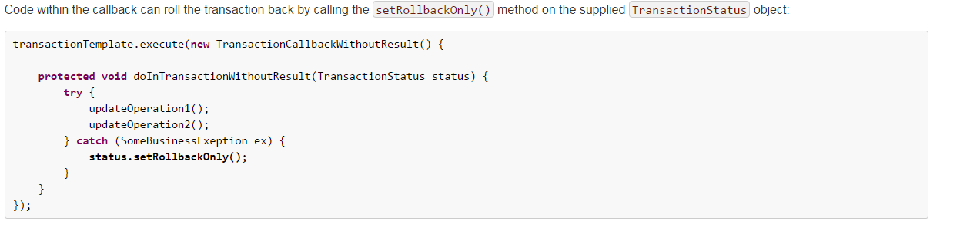

Slide 44
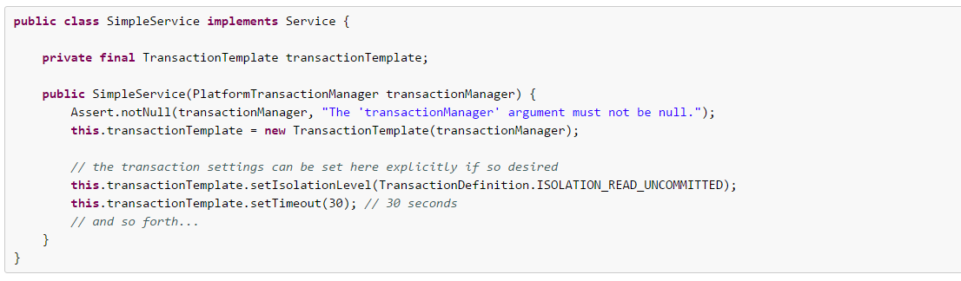
Specifying transaction settings

Slide 45
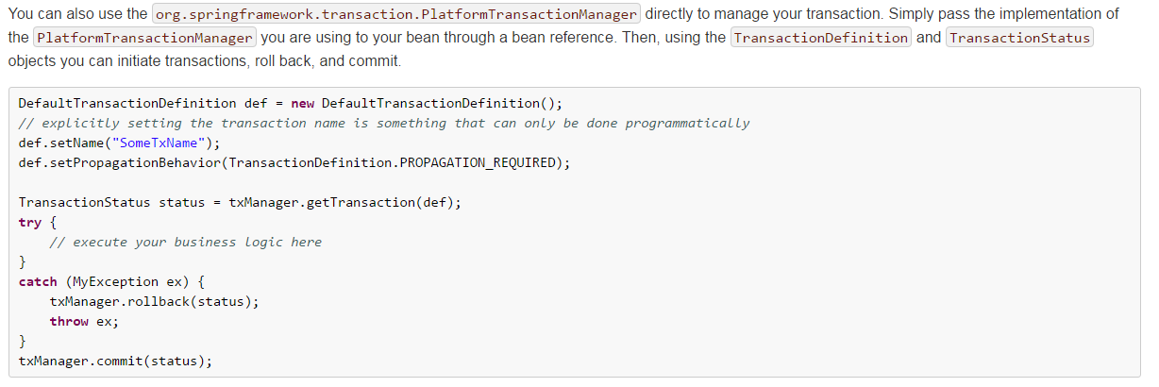
PlatformTransactionManager

